Slide 1
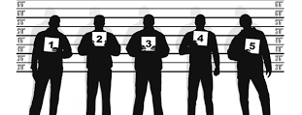
Human memories are not reliable.
Eye witness misidentification leads to thousands of innocent people being locked up every year.

Slide 2
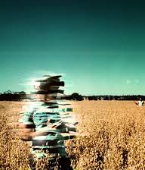
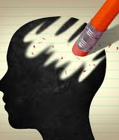

Memories are not like a videotape or a picture. Memories are vulnerable to contamination.
As people age so do their memories, which causes memories to change and metamorphosize.
Every time you recall a memory there is a slight change to that memory, so ever time that memory you have can be completely different from the original.

Slide 3

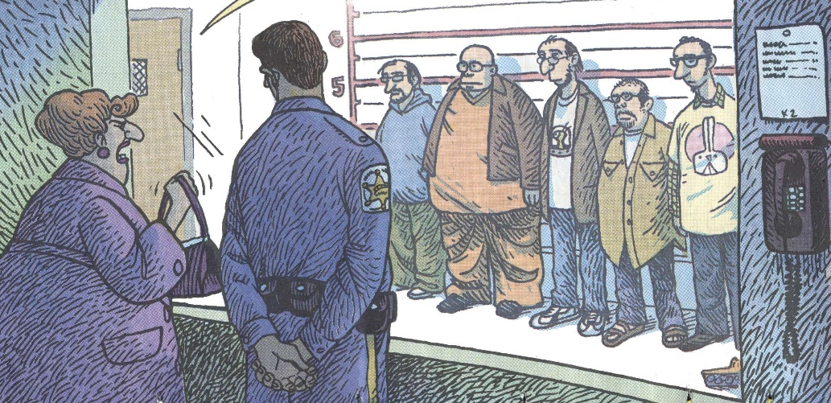
The criminal justice system does eye witness identification line ups wrong.
When police officers line up 6-9 people for a victim to pick the offender from, the victim feels compelled to pick someone from that line up even if the offender is not there.
Police are not required to tell the victim the possibility that the offender might not even be in the line up.
Studies show that the right way to do a line up is to show the possible offenders in a sequential line up one at a time.
The overall regulations for line ups are very similar to the regulations when the line ups were first invented in 1874.

Slide 4
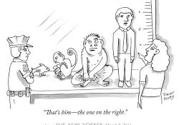
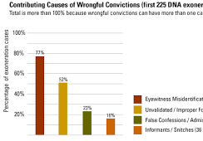
Eye witness testimonies should not be heavily weighted evidence in a court case.
Eye witness error is the leading cause for wrongful convictions.
People are not perfect, they make mistakes.
Eye witness misidentification is the cause for 70% of wrongfully convicted individuals.
DNA evidence exonerated 3.3%-5% of the capital rape and murder convictions in the United States for 1982-1989, if these statistics applied to all convicted felons 33,000-50,000 people would be wrongfully convicted every year in the United States.

Slide 5
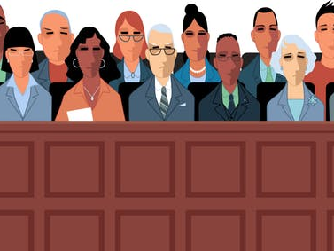
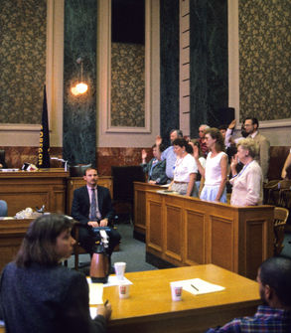
Jurors think that eye witness testimonies are 100% accurate.
Juries are not educated on the human memory and how unreliable memories are.
Surveys show that juries place eye witness identification as heavily weighted evidence that helps them decided if the alleged offender is guilty.
Juries and judges should be required to learn how the human memory works and why it is not 100% reliable.

Slide 6
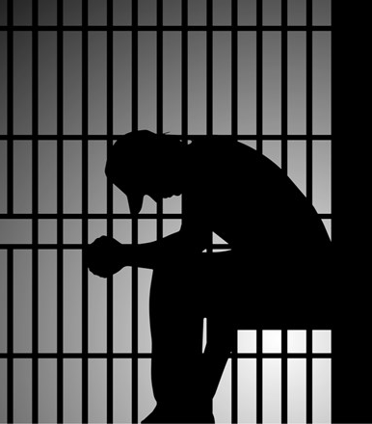
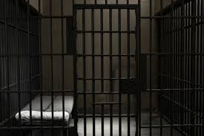
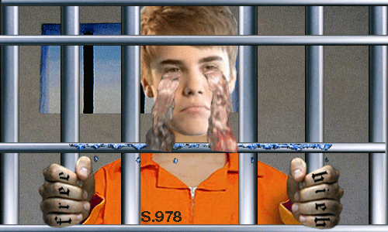
Eye witness testimonies are erratic and should not be counted as heavily weighted evidence.
Eye witness misidentification leads to thousands of innocent people being locked up each year.
Peoples memories are always changing, which can lead to eye witness misidentification
Methods the criminal justice system uses are out of date and need to be updated.

Slide 7
Works Cited
Opfer, Chris, and Chris Opfer. “The Problem With Police Line-Ups.” CityLab, CityLab, 19 Feb. 2013, www.citylab.com/equity/2013/02/problem-police-line-ups/4724/
Weir, Kristen. “Mistaken Identity Is Eyewitness Identification More Reliable than We Think?” American Psychological Association, American Psychological Association, Feb. 2016, www.apa.org/monitor/2016/02/mistaken-identity.
Wise, Richard A. and Safer, Martin A. “A Method for Analyzing the Accuracy of Eyewitness Testimony in Criminal Cases.” American Judges Association, 2012, https://digitalcommons.unl.edu/cgi/viewcontent.cgi?article=1390&context=ajacourtreview

